Slide 1


Slide 2

Leading the Charge!

Slide 3
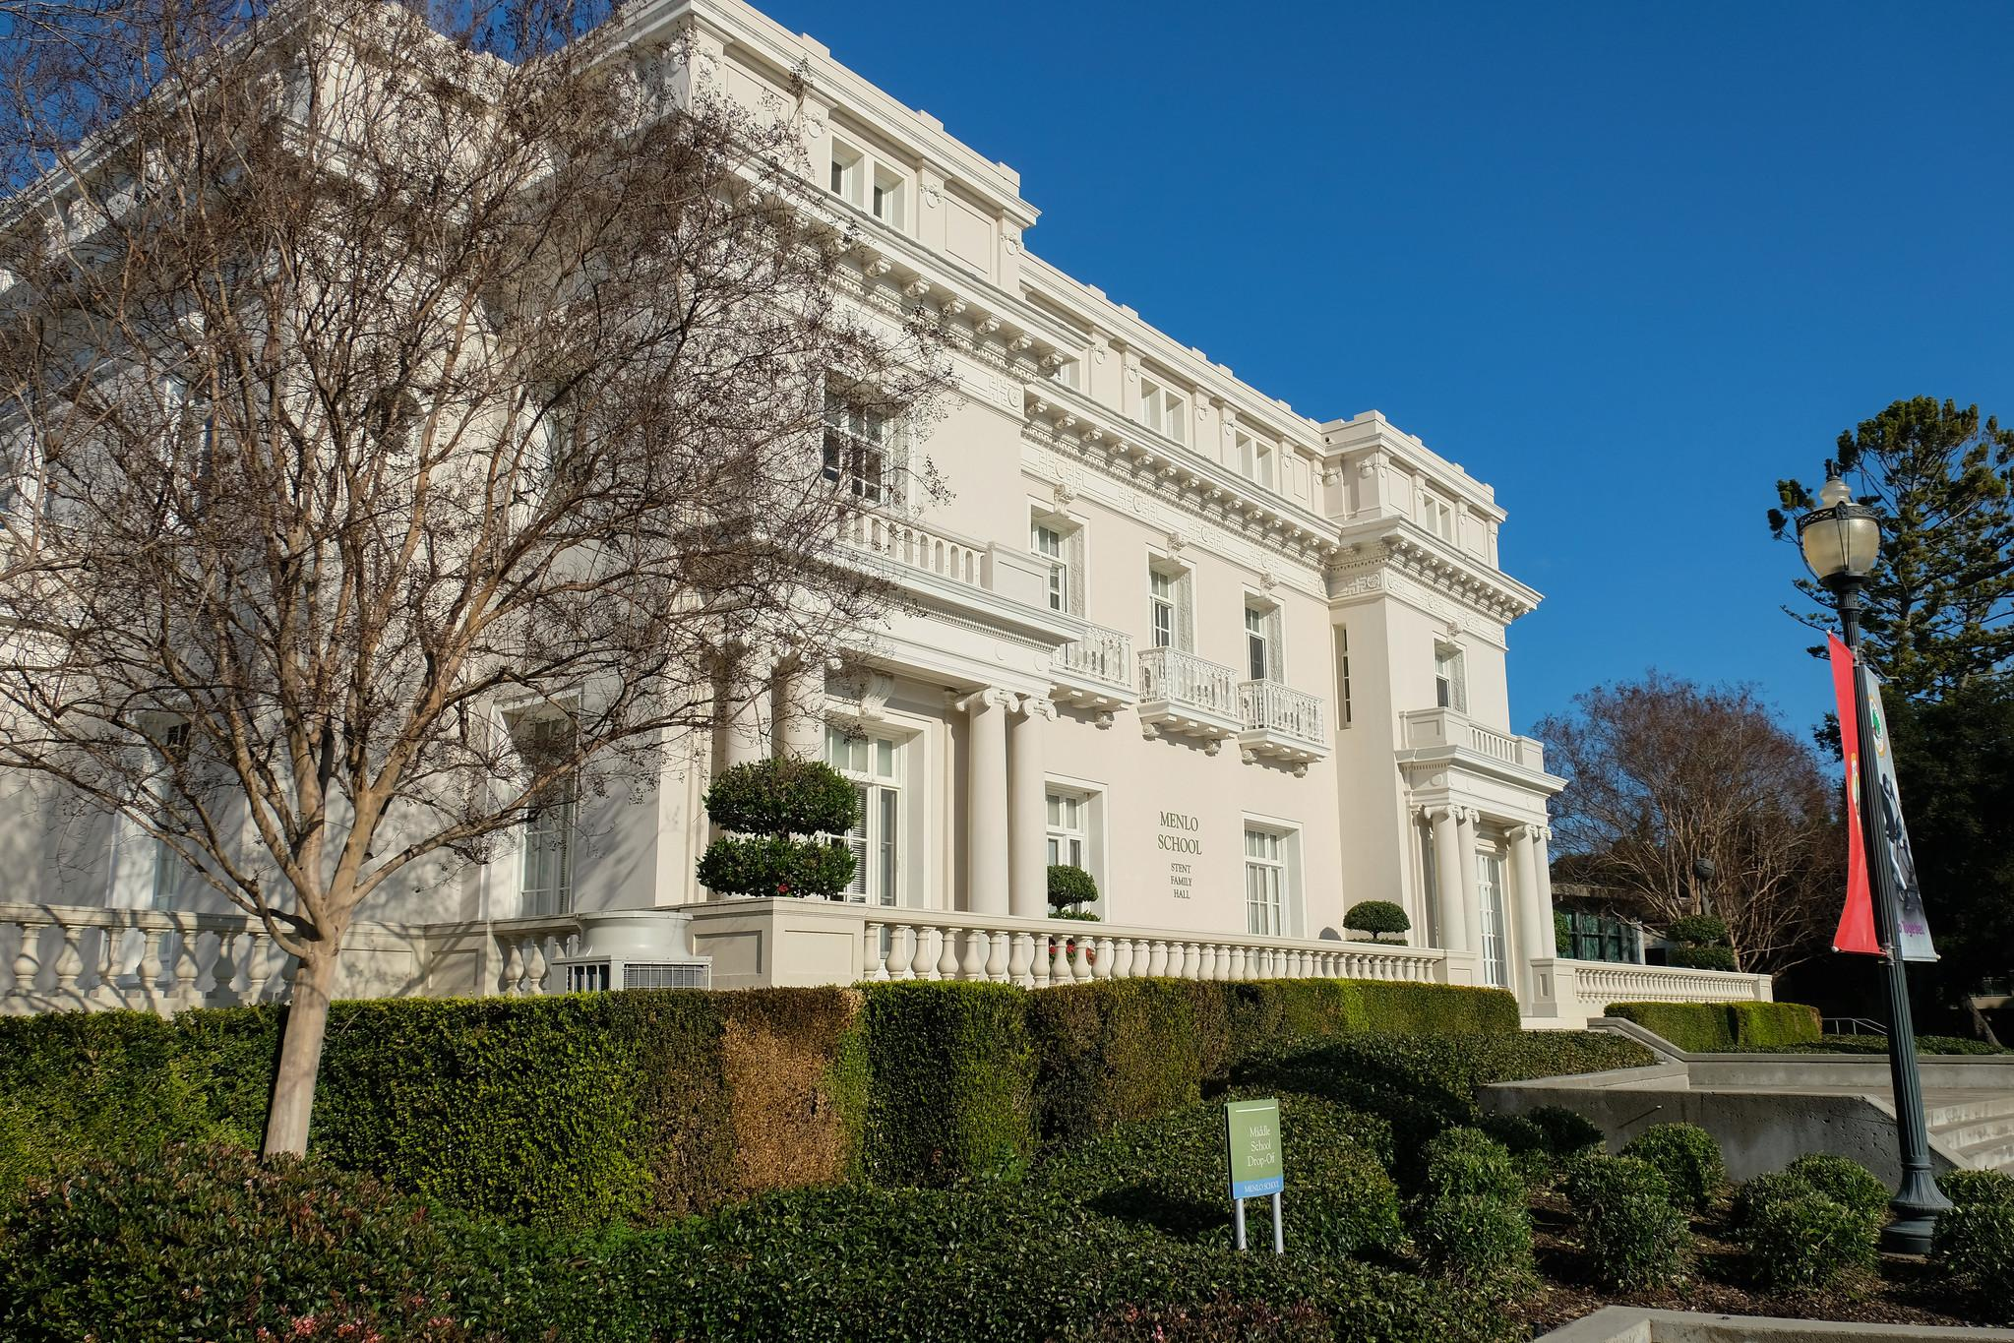
Support

Slide 4
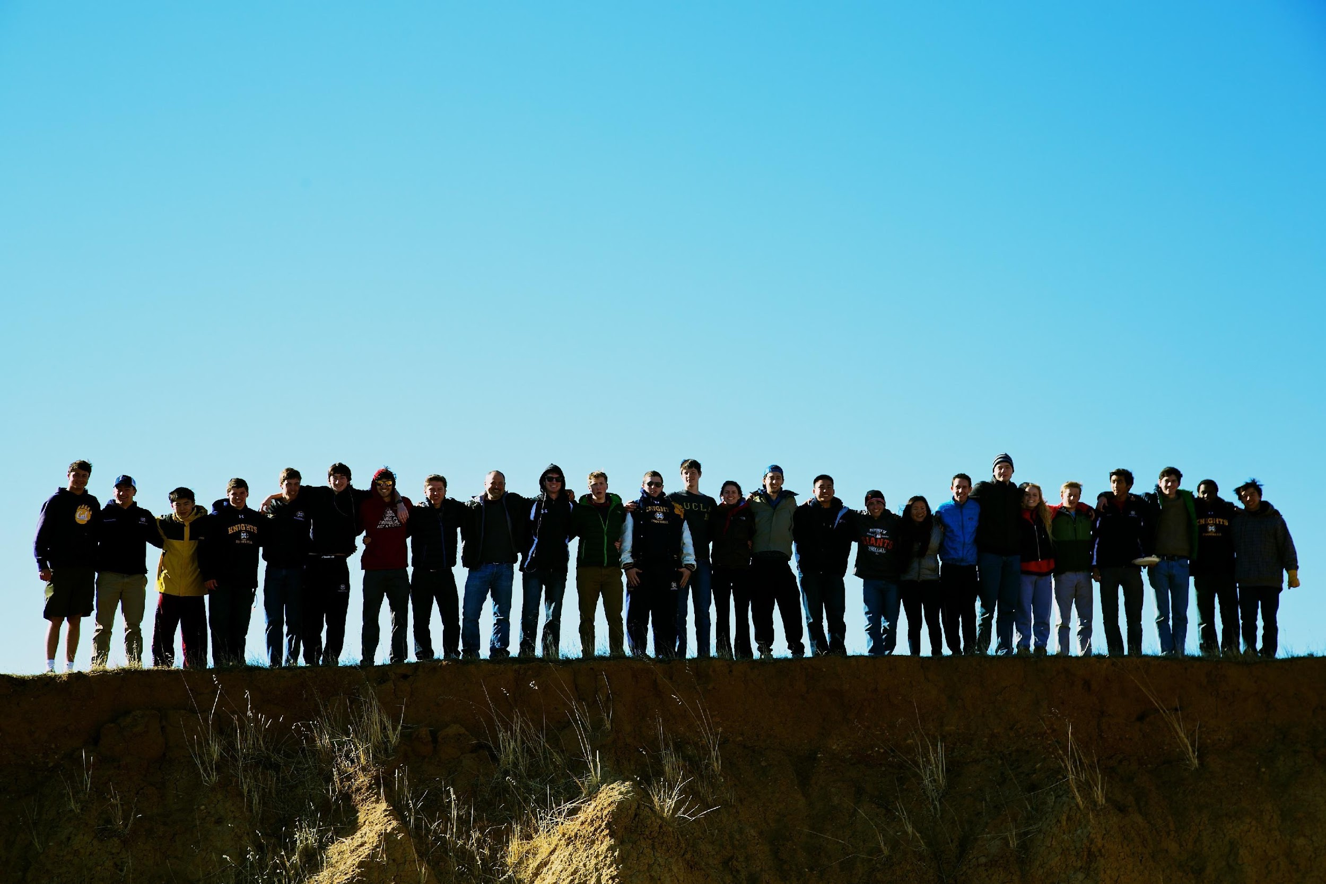
Community

Slide 5
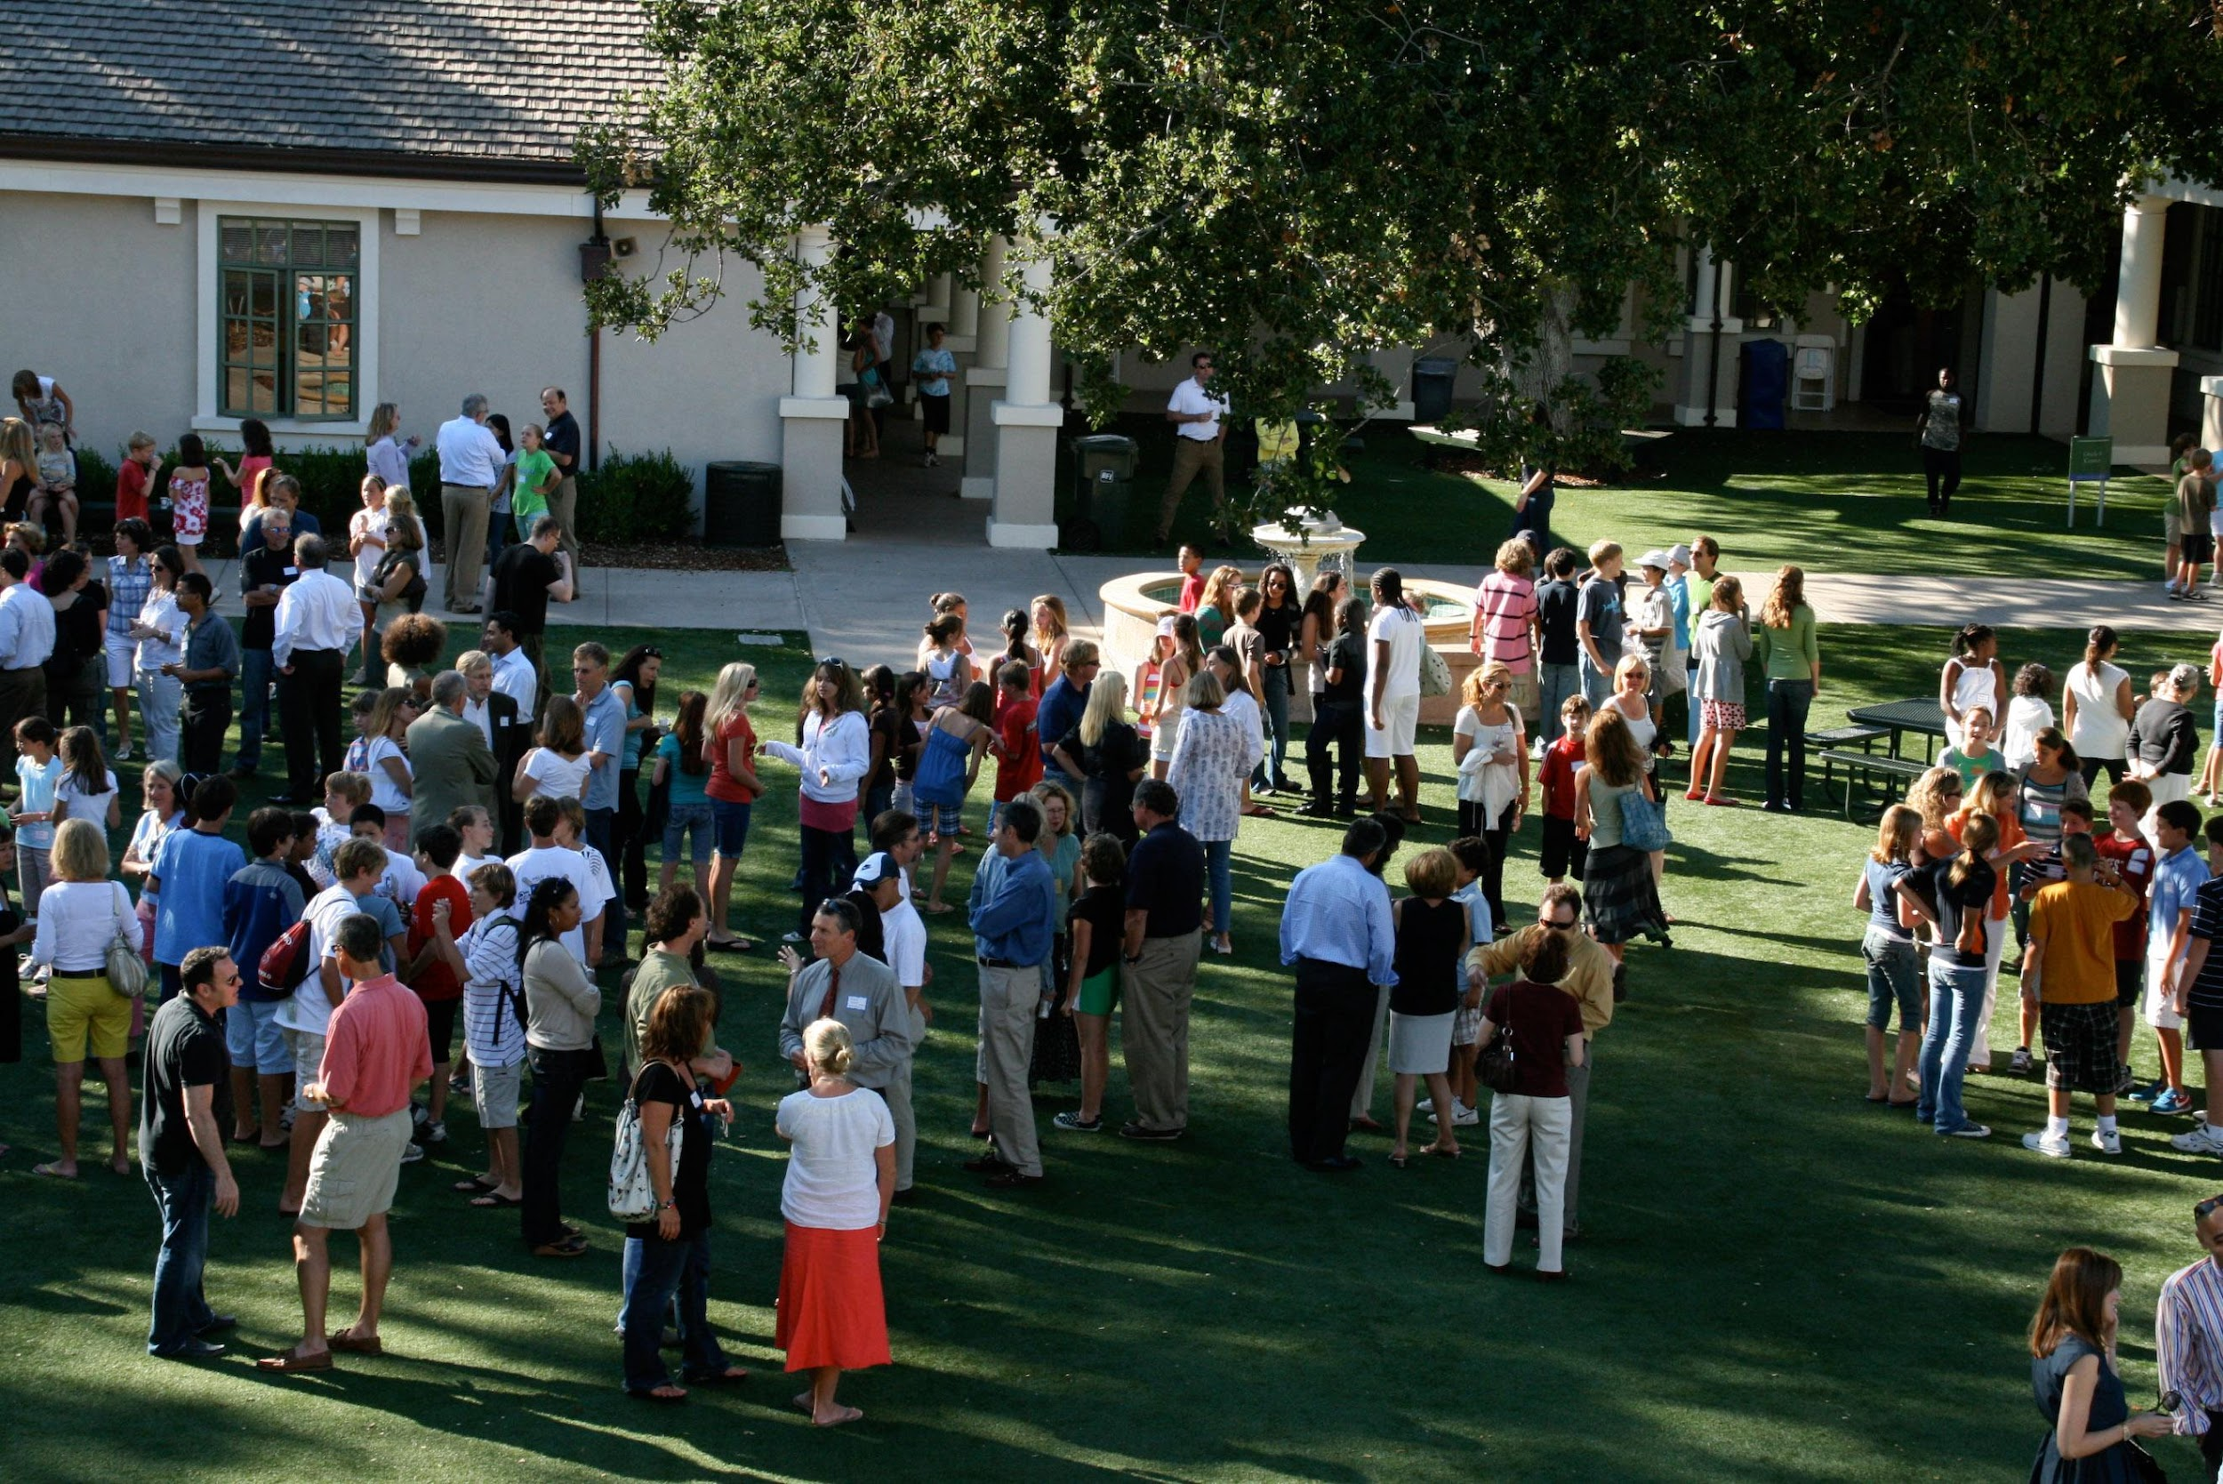
Ambassadors

Slide 6
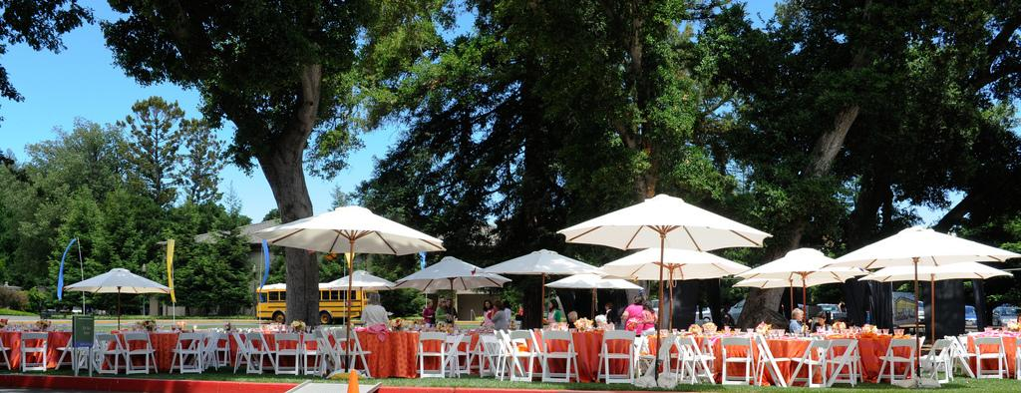
Setting the Tone

Slide 7
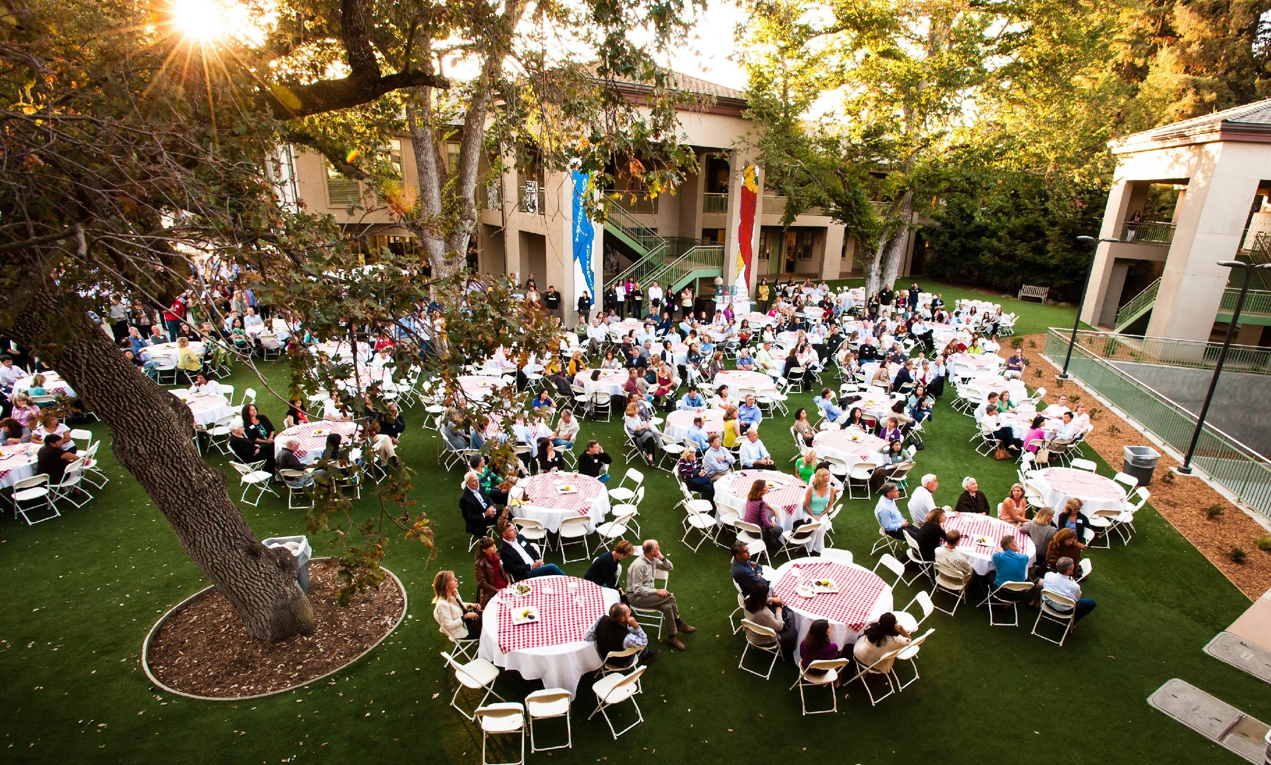
A successful event can be measured by how well it maps on to the core values of the school.

Slide 8

What are Menlo’s core values?

Slide 9
Menlo School’s mission is to empower students to explore and expand their interests, reach their fullest potential, develop the skills necessary for success in college, and become ethical, responsible, and engaged members of ever wider communities.

Slide 10
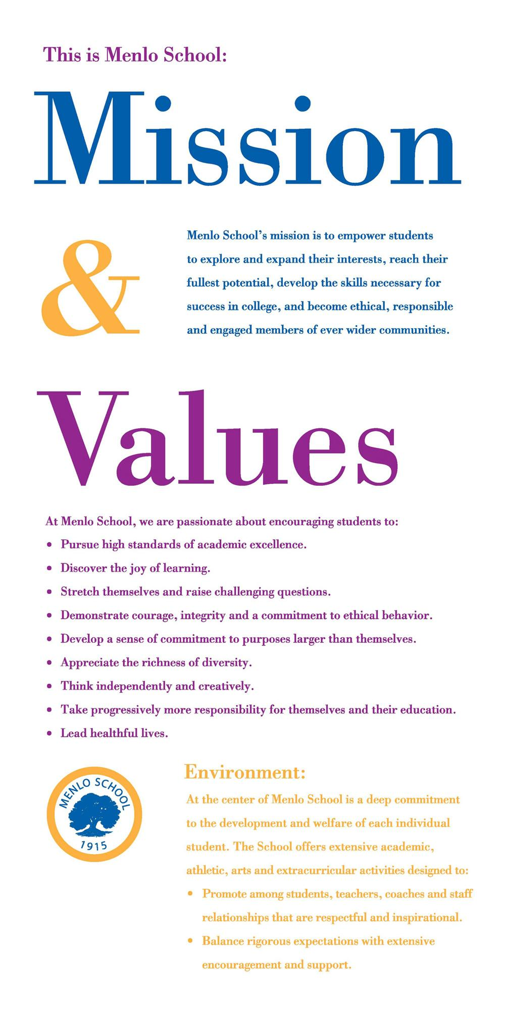
Mission and Values

Slide 11


Slide 12
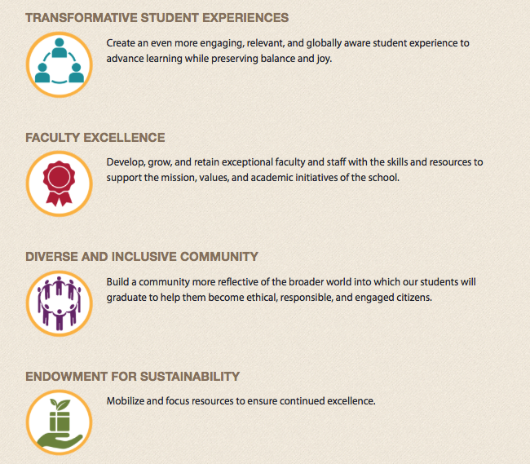
Highlights of the Strategic Plan

Slide 13
Clear and Consistent Messaging

Slide 14
Who is the intended audience?
What do you want the reader to know?
Is there a call to action?
Is it on strategy?
Clear and Consistent Messaging

Slide 15
Thematic Approach

Slide 16


Slide 17
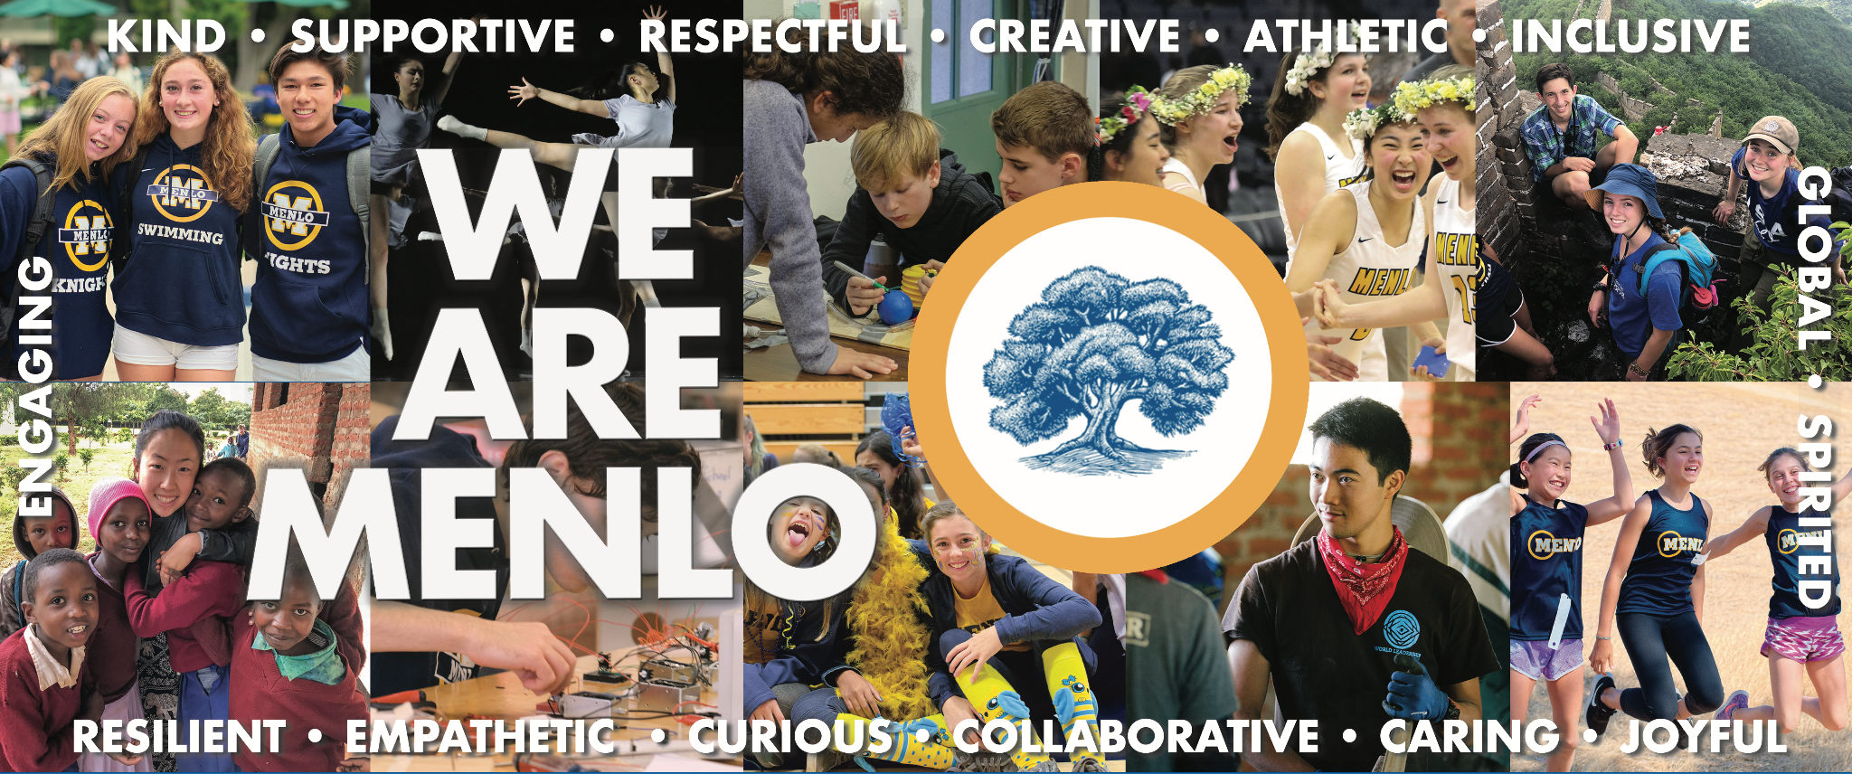

Slide 18
Using the Brand

Slide 19
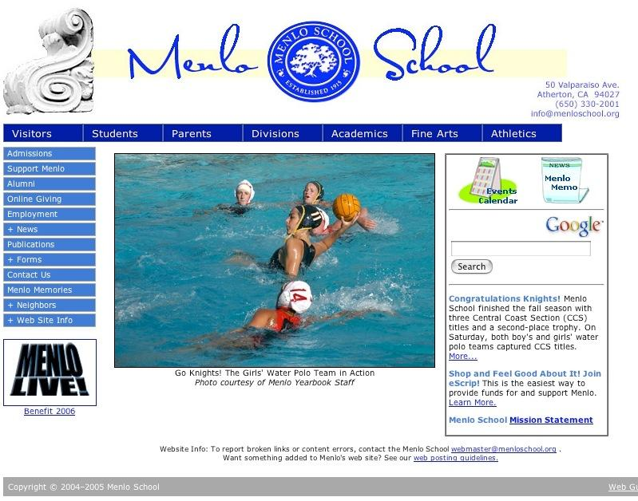

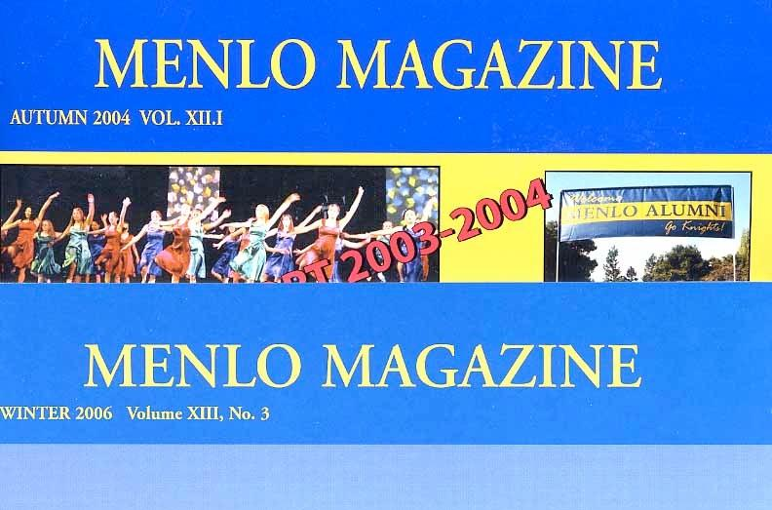

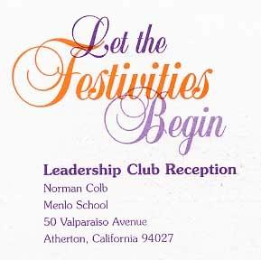

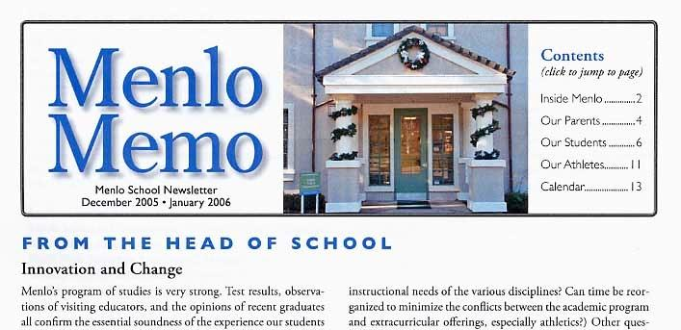

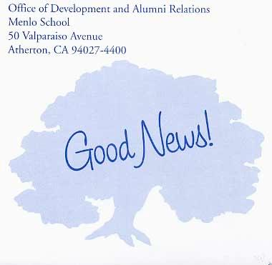
Menlo School – Identity

Slide 20
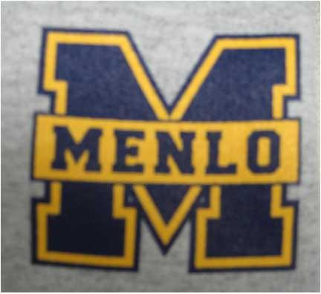



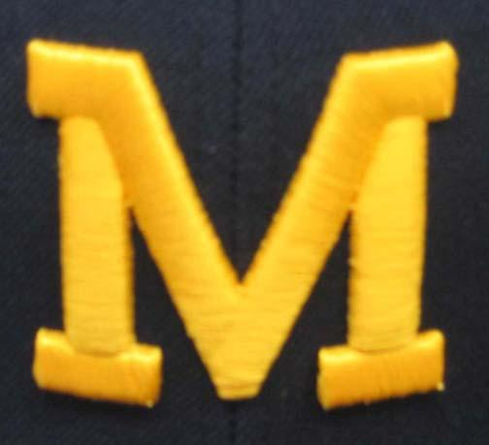

Menlo School – Identity

Slide 21


Slide 22

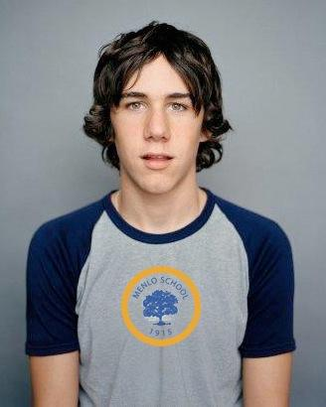


The new Menlo identity: “Diversity with Unity”

Slide 23

Is it okay to use the “M”?

Slide 24
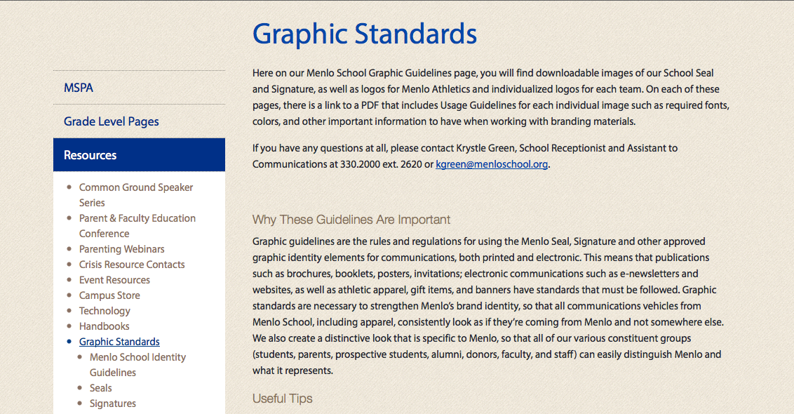
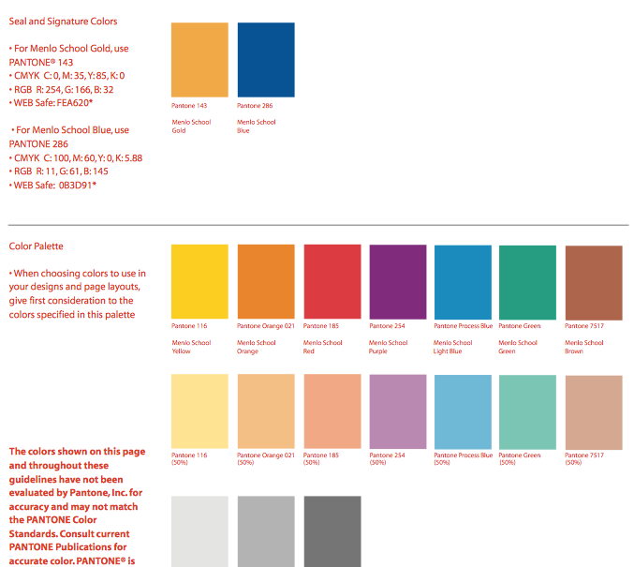
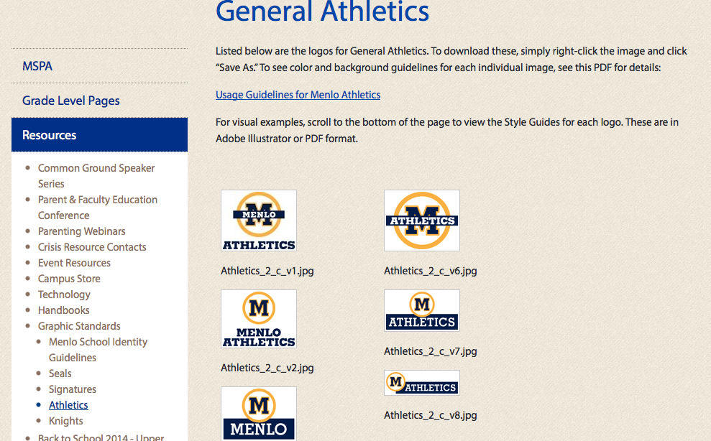

Slide 25
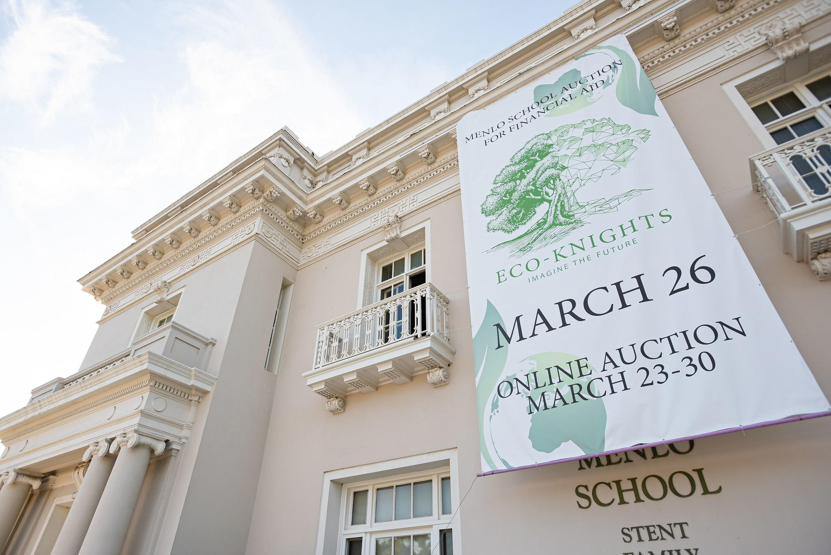
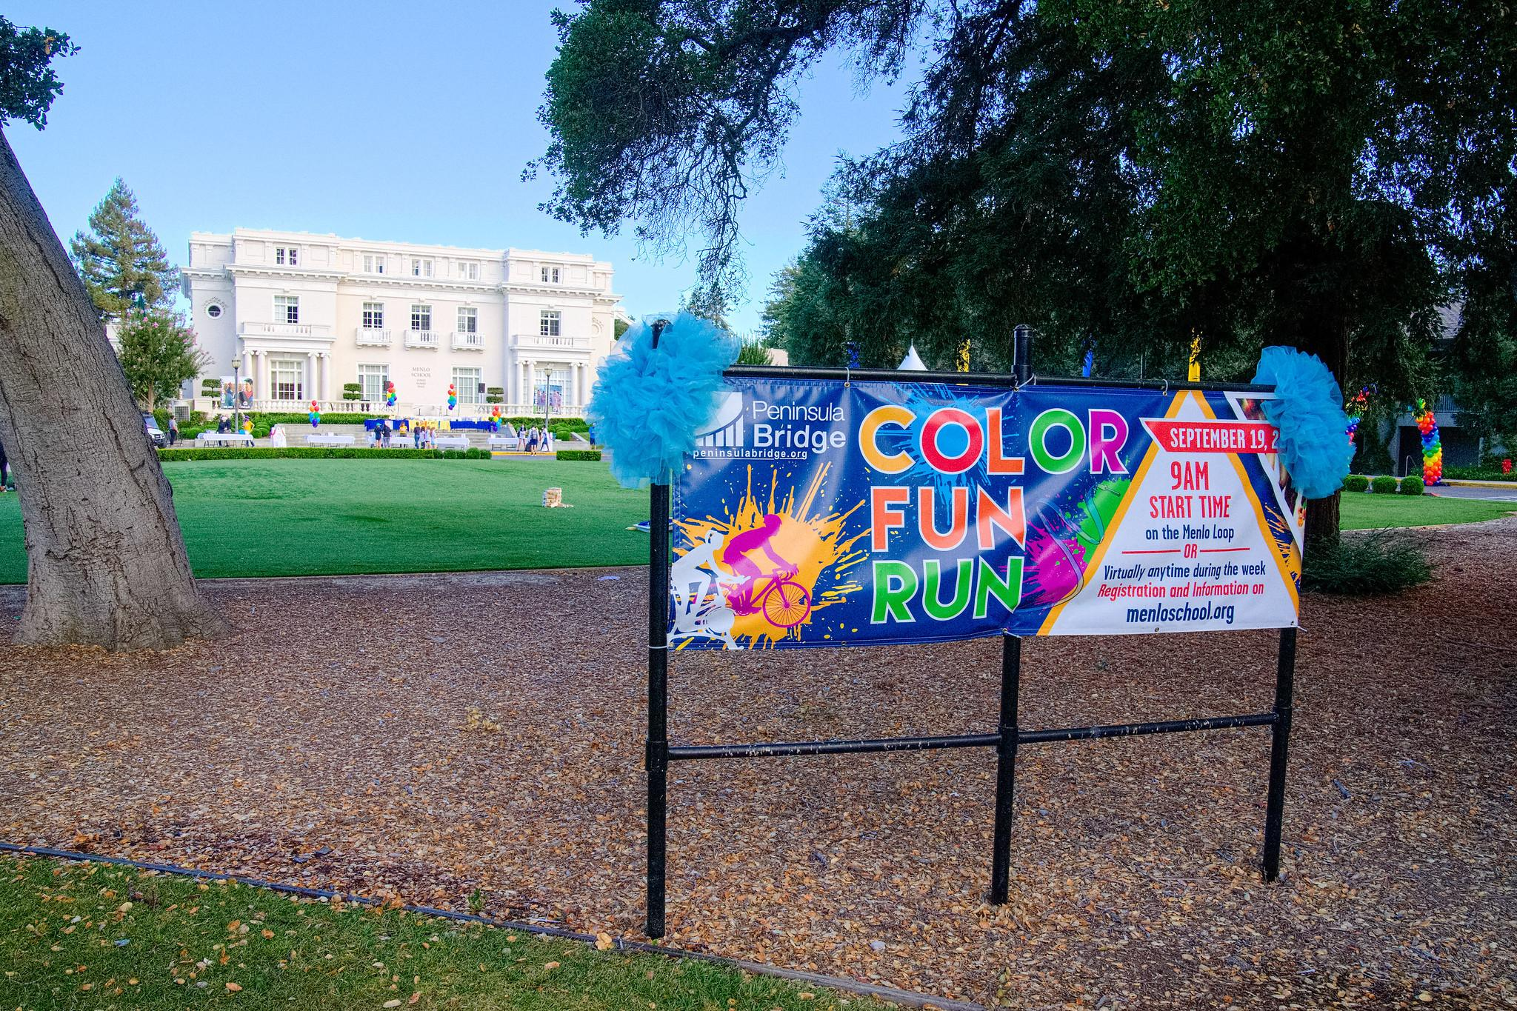
Knowing which communications tool to use

Slide 26
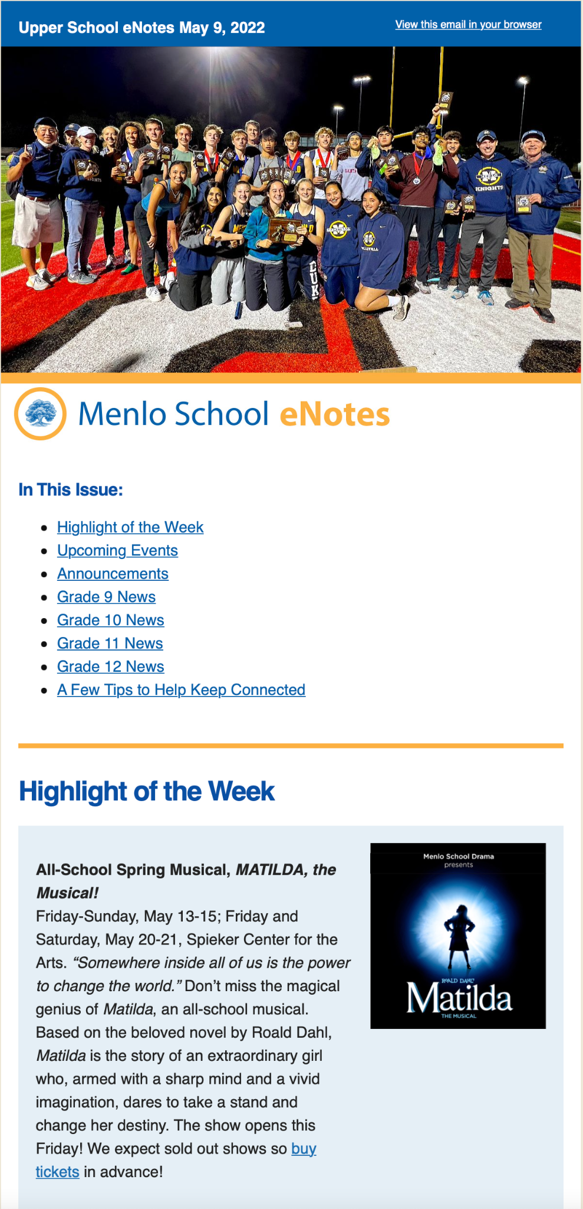
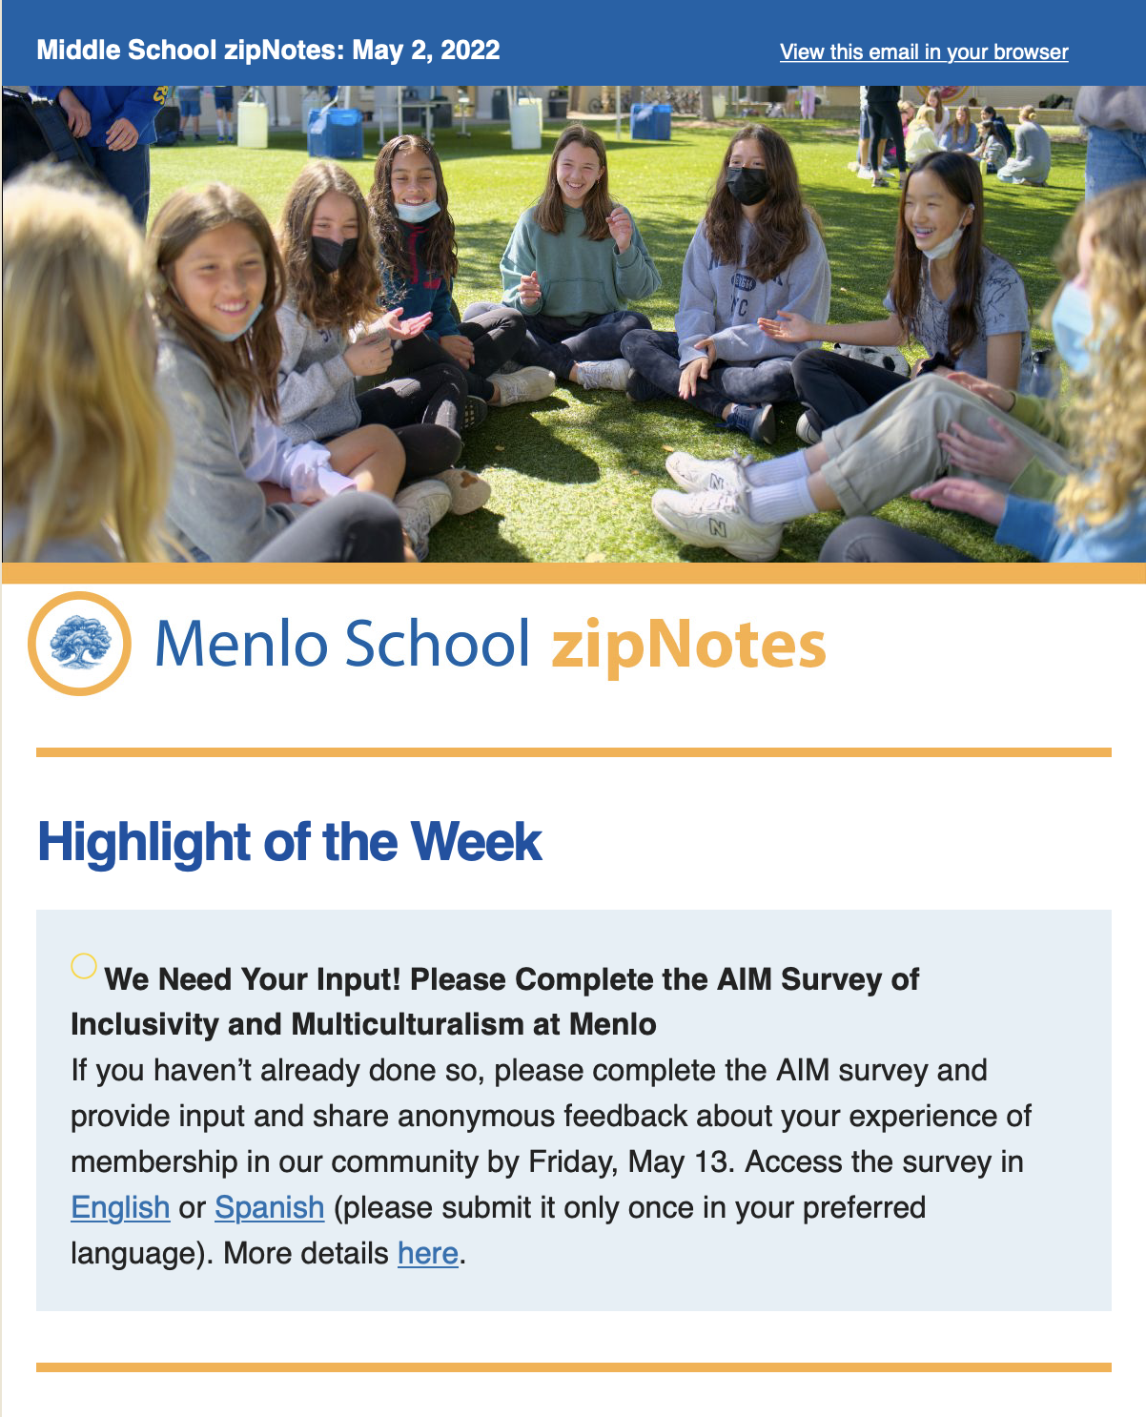
eNotes & zipNotes

Slide 27
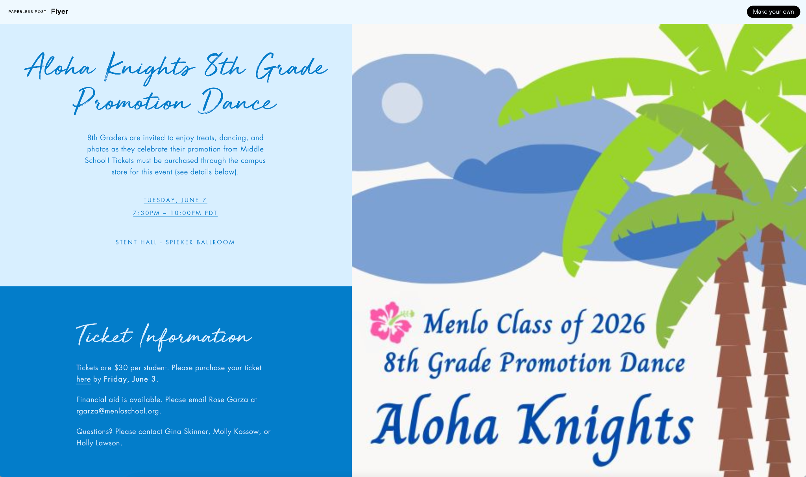
Invitations, Sign Ups, and Translations

Slide 28
Who do I turn to for help?

