Slide 1
Turning adversity into opportunity
How Resilience Can Be Learned
Alex Lickerman, M.D.
Notes:
The title of my talk comes from the title of a book I wrote

Slide 2
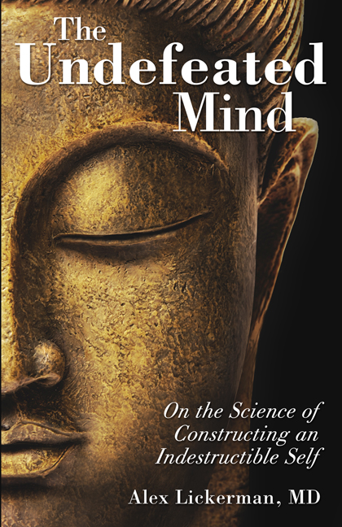
About Me
Primary Care Group
Student Health
Buddhist
Writer
Notes:
How I failed the Board part I and almost didn’t become a doctor.

Slide 3

Notes:
Resilience is a two-sided coin:
Not just surviving but thriving in the face of adversity
Refusing to give up when facing obstacles
Can it be taught? I believe so.
I’m going to discuss four strategies for increasing your resilience, the first two to help you with resisting discouragement when obstacles arise and the last two to help you better weather adversity.

Slide 4
Expect Obstacles
Our expectations influence our responses to our experiences
Our expectations about task difficulty influence our performance and likelihood of quitting
How can we leverage our expectations to improve our performance and decrease our likelihood of quitting?

Slide 5
Self-Explanatory Style
Self-explanatory style refers to the style with which we explain the causes of events (e.g., why we failed a test)
Optimistic self-explanatory style:
  “Not my fault” (i.e., avoids self blame)
  Effects are limited in duration
  Effects are limited in scope
Pessimistic self-explanatory style:
  “Something is wrong with me that I can’t change”
  Effects will continue forever
  Effects affect everything
Notes:
When trying to achieve a goal, what stops us? We do ourselves. But with what? The stories we tell ourselves.

Slide 6
Self-Explanatory Style and Depression
Suicidal ideation
Negative life events
Hirsch et al., 2009
Notes:
138 students were given the Expanded Attributional Style Questionnaire to determine their self-explanatory style and the Lifetime Incidence of Traumatic Events questionnaire was used to determine the number of traumatic events and their emotional impact when they happened and at the time of the study. The Beck Scale of Suicide Ideation plotted on the y-axis.
Jameson Hirsch et al., “Optimistic Explanatory Style as a Moderator of the Association between Negative Life Events and Suicidal Ideation,” Crisis 30 (2009): 48-53.

Slide 7
Self-Explanatory Style, cont.
Naïve vs. realistic optimism
Depressive vs. defensive pessimism
True goal: realistic optimism/defensive pessimism

Slide 8
Changing Our Self-Explanatory Style
Practice imagining alternative causes of events
Avoid blanketing optimistic explanatory biases over all situations
Fresco et al., 2009
Notes:
On the other hand, if we tend toward a depressively pessimistic self-explanatory style, we need to practice refuting self-defeating views. In one study designed to evaluate the effects of self-administered optimism training, researcher David Fresco and colleagues asked subjects to identify both the best and worst events they experienced over thirty days and to offer explanations for their causes. Half of the subjects were then asked to offer revised explanations. (Hoping to make the training as simple as possible, the researchers asked subjects to look not for more optimistic explanations but merely for alternative ones, presuming that further reflection would yield more optimistic thinking as a natural consequence.) Surprisingly, at first the subjects produced revised explanations that were even more pessimistic than the ones they offered initially. But by the end of the study, apparently with enough repetition, both their initial and revised explanations had become less pessimistic than those of the control group.
Why bother to do this? Because of the benefits of optimism: not that it makes us try harder but that it makes us try more.
David Fresco et al., “Self-Administered Optimism Training: Mechanisms of Change in a Minimally-Supervised Psychoeducational Intervention,” Journal of Cognitive Psychotherapy 23 (2009): 350-367

Slide 9
Accept Pain
Distraction with something that arouses emotion
Acceptance and Commitment Therapy (ACT)
Notes:
I’m going to talk about the virtue of accepting pain, first using physical pain as an example but then moving to emotional pain.
Physical pain is experienced in two separate areas of the brain, one that registers its intensity, quality, and location (the insula) and the other that gives pain its unpleasant character (cingulate cortex).
This explains how different people can have different pain tolerances AND
How something like the meaning of pain can affect how much it makes us suffer.

Slide 10
Accept Pain, cont.
Identify a situation that causes painful emotion(s) to arise (e.g., social anxiety)
Identify goals that painful emotion obstructs
Practice non-judgment/acceptance

Slide 11
Let Go
Sense-making
Benefit-finding
Notes:
Journalist with brain cancer: hope the enemy.
We will lose our attachments. We will fail to accomplish some goals. Sometimes, letting go is what it means to be resilient.

Slide 12
Mean Adjustment Score
Adjustment Measure
Davis et al, 2000
Notes:
The dangers of sense-making:
80% of people ask themselves “Why me?” when tragedy strikes, but 50% of them fail to find a convincing reason.
In this study 124 parents who lost a child to SIDS were interviewed 3 times: 2-4 weeks after their baby died, 3 months post-loss, and 18 months post-loss.
SCL-90R (Symptom Checklist) measures depression and somatization
Christopher Davis et al., “Searching for Meaning in Loss: Are Clinical Assumptions Correct?” Death Studies 24 (2000): 497-540

Slide 13
Let Go, cont.
Avoid attempts to “undo” past events

Slide 14
Stages of Change Model
Precontemplation
Contemplation
Preparation
Action
Maintenance
Relapse
Notes:
Cutting across all these 5 principles is a process people go through in surrendering their attachment to the status quo. This process is described by the TTM of Change, which was originally developed to describe the 5 stages people go through when making a behavioral change. But recent research suggests it also can be used to describe 5 distinct stages by which people let go of attachments.
Precontemplation: a stage in which conscious recognition of the need to let go of an attachment hasn’t yet occurred. In this stage people know that they need to let go of their attachment but haven’t yet. They may say they feel “numb” in this stage—or perhaps behave as if they haven’t suffered a loss—but what they really mean is that they feel unable to sort out all the emotions they may be feeling.
Contemplation: when the emotional tumult of precontemplation starts to abate. At that point, people typically come to realize that they’re still attached to what they’ve lost and that they have to make some kind of decision to let go of it, even as they typically remain ambivalent about doing so. What ultimately resolves this ambivalence and moves them from this stage into the next is when the idea that letting go is important changes into the belief that they actually need to. Buddhist idea of “understanding something with your life.” Cigarette smoking example.
Preparation: people finally recognize they have to move forward and begin to muster the determination to do so. Because moving from contemplation to preparation means transitioning from ambivalence to determination, resentment often resurface in this stage. People often feel confused, afraid, and overwhelmed by the prospect of working in a new way.
Action: This is fully accepting their loss.
Maintenance: Living without their attachment.
Relapse: a return to grief.
The value of becoming aware of these stages is two-fold: it helps people undergoing change mark their progress; naming the stage in which someone finds himself may empower him. It also suggests effective ways for leaders to nudge people forward if and when they get stuck. For what would make a strategy effective for resolving attachment to the status quo will depend on the stage in which someone finds himself. While jumping over a stage isn’t, strictly speaking, impossible, it is in general more difficult than taking the time to “ripen” your people gradually from one stage to the next.
The length of time someone occupy a stage may be short--seconds, even--but when it comes to letting go, the fastest way to action and then maintenance seems to be through precontemplation, contemplation, and preparation.

Slide 15
Find Me
alickerman@gmail.com
www.alexlickerman.com

